Slide 1
Arduino in Classrooms
Katana Dunn, Burnside High School

Slide 2
Who am I?
Electronics Engineer
Robotics - Robocup, Vex Robotics, Arduino
Electronics at Burnside High School
Playing with electronics, programming, computer, robotics, 3D printer, laser cutters etc ( until I get bored) - assessment can take the fun out of it
Motorcycling, Gamer, Nature

Slide 3
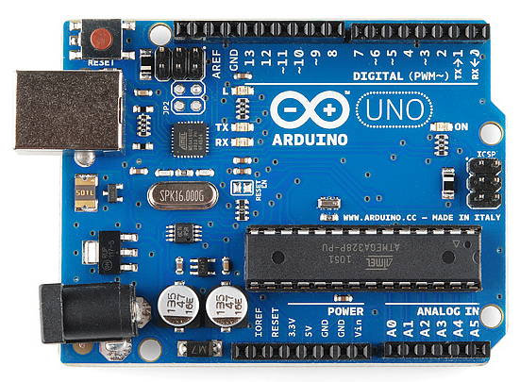
What is Arduino?
Open-source prototyping platform
Types of Arduino
Arduino Interface
Arduino Programming Environment

Slide 4
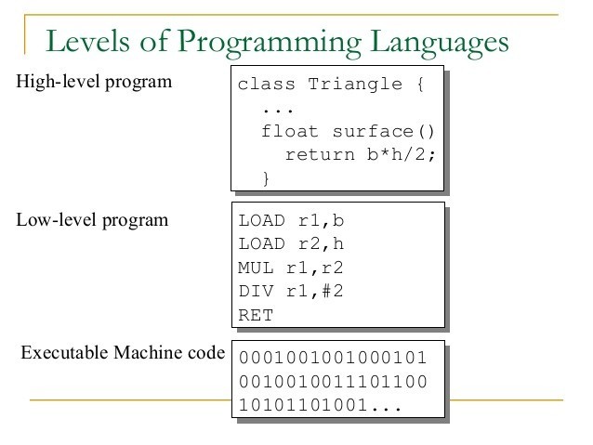
Open-source prototyping platform
Can be cloned within rules
Easy to use software and hardware where the complexities of integrating/controlling hardware has been taking care of
Instead of worrying about low-level design (hardware and software) we can focus on a task.

Slide 5
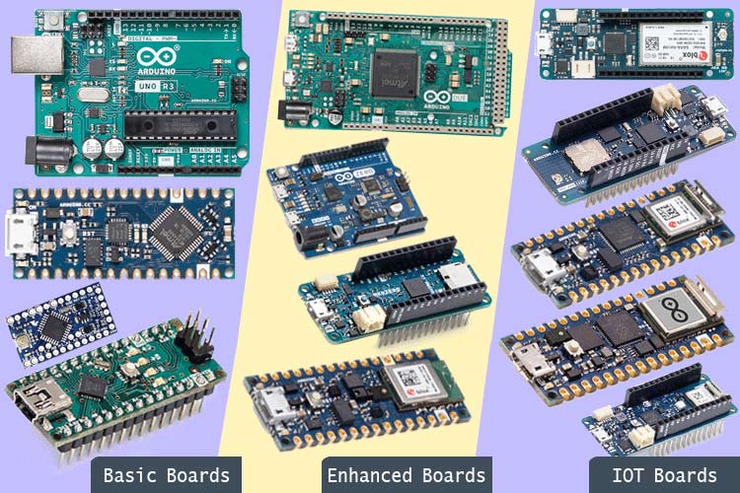
Types of Arduino
Mostly use:
Uno
Mega
Nano
ESP8266 (same software)

Slide 6
Arduino
Interface
Power
Programming
Digital Input/Outputs
Analog Input
Analog Output (PWM)

Slide 7
Arduino Programming Environment
Tinkercad Circuits are really handy to use as it has a simulation environment. Also PictoBlox
Arduino IDE - locally installed
Arduino Web Editor
Use Arduino with Chromebooks

Slide 8
References and Resources
Link to this resource folder - http://bit.ly/3GE2kbN
Burnside High School Digital Technologies website - Arduino .There are other resources you can explore as well.
Arduino - Lots of resources from the main site. Especially the language reference

Slide 9
Getting to know the Arduino
Jumping in versus teaching the theory behind it
Using Components vs System Boards/Shields
Using Simulation to explain Software and Hardware Concepts
Digital Input and Output
Analog Input and Output
Adding LEDs, switches, potentiometers, motors

Slide 10
Assessments and Arduino
Electronics/programming/mechanical, housing etc.
Own code vs libraries
NCEA Level 1 vs Level 2 vs Level 3 - Electronics Outcome
External Level 2 and 3: Be aware of “digital outcome”
Expectations at Y9 and Y10 (The Burnside Program)
Programming Standard and Arduino

Slide 11
Electronics Outcome (Internal)
Level 1 | Level 2 | Level 3
Appropriate techniques | Advance techniques | Complex techniques
Ohm’s Law Hardware and software Modify existing code Soldering | Using embedded software Subsystem level design Remote control Advanced printed circuit board (PCB) development Data storage (EEPROM) Analogue to digital conversion (ADC). | Implementing communication protocols e.g. i2C, serial communications Wireless transfer of information Feedback control Implementing software flags and interrupts CAD design, 3D printing, CNC, PCB making, filtering, noise and EMI suppression.

