Slide 1
Introduction to robotics by building robots and engaging with robot concepts
Shen (Hin) Lim, David McCauley and Alicia Sim

Slide 2
School of Engineering of University of Waikato
Mechatronics
Mechanical
Electrical and Electronics
Software
Civil
Environmental
Chemical and Biological Processing (CaBE)
Material Processing (MaPE)

Slide 3
Interactive engagement
Multiple displays in the room
A brief introduction and motivation about robot concepts for students, including more general STEM related concepts
Break into multiple stations of the displays for interaction and discussions with us (Hin, David and Alicia)

Slide 4
Partnership Through Collaboration Workshop
A 3-hours workshop for Year 9 and 10 – Project 1
4 sessions every year since 2018
On campus or visiting high school
About 14 schools
Key is to get students engagement and interests to robotics concepts

Slide 5
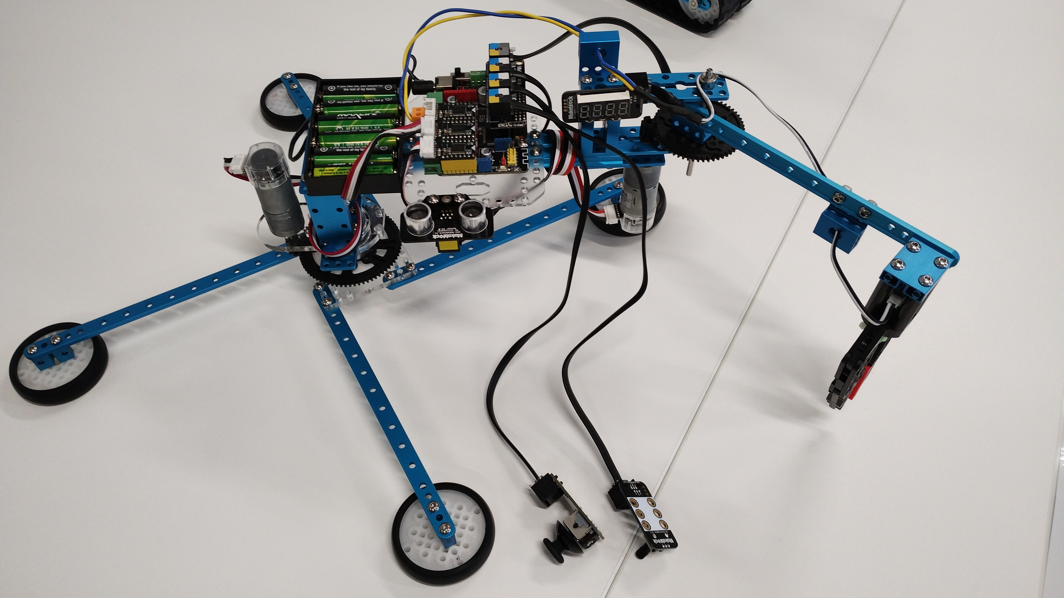
Project 1: Autodidactic crane
Sense (Human)
Think (Controller)
Act (Motor)
Act (Motor)
Act (Gripper)
Sense (Ultrasonic)
Relay (Joystick and Potentiometer)

Slide 6
Project 1: Autodidactic crane
Main engagement: self-directed learning experience (Focusing on “act”)
Students build the crane from pre-assembled parts by observing and extracting information from a completed model
We do not provide a written manual and we encourage them to try and build and not be afraid to fail
Students manage to connect how things are assembled together
Once fully assembled, they can control the crane with preloaded program

Slide 7
Follow up sessions in Project 1
Now that they have seen how it operate, they can see how the “brain” works
Guide how “sense” and “think” can relate to “act” via programming
How to setup ultrasonic sensor – what it takes to read distance
How to get joystick and potentiometer react to human sense
Up and down
Left and right
Min to max
How to get the motor to react to joystick and potentiometer

Slide 8
BEARIE
Aim to develop interactive STEM development platform for students while easily maintained and affordable by teachers
Encourage students to self-teaching
Based on common Python/Arduino language
Develop a basic platform that has commonly found and replaceable hardware of controllers, drivers, sensors, actuators and display
Provide support for teachers
Made in NZ, made for kiwis

Slide 9
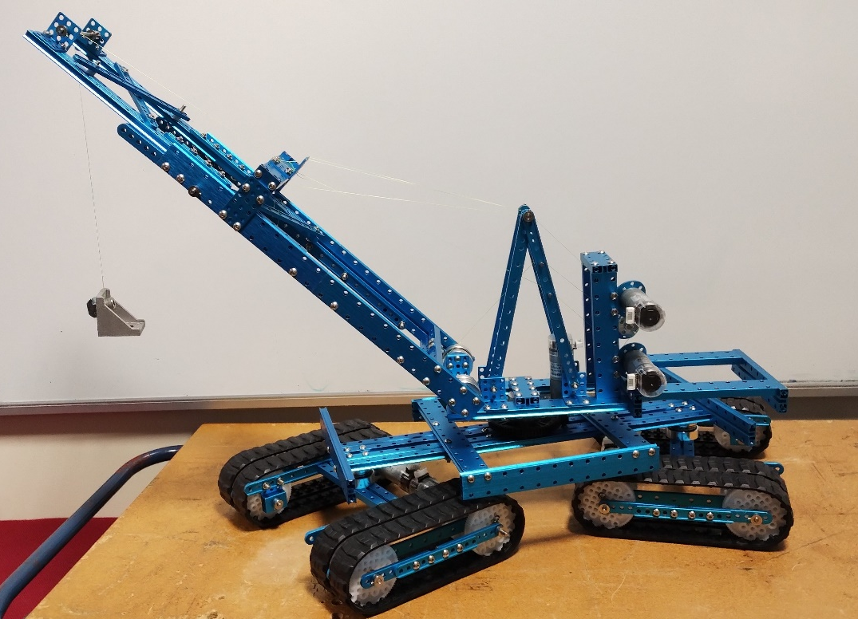
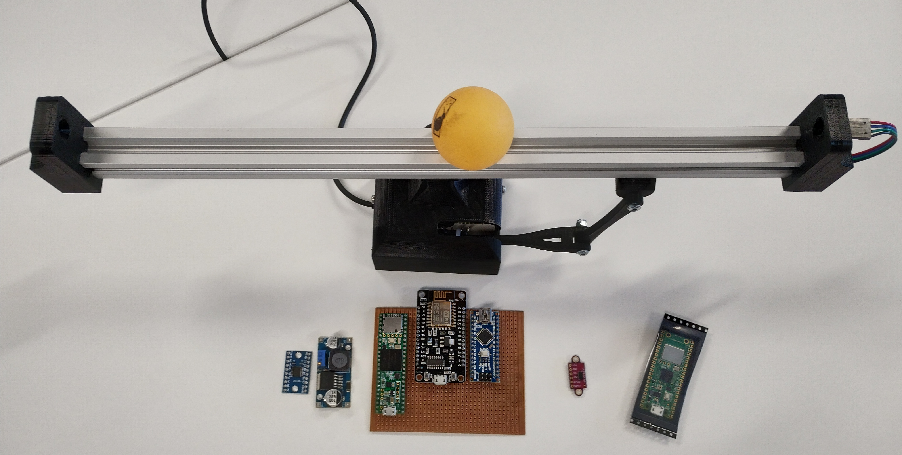
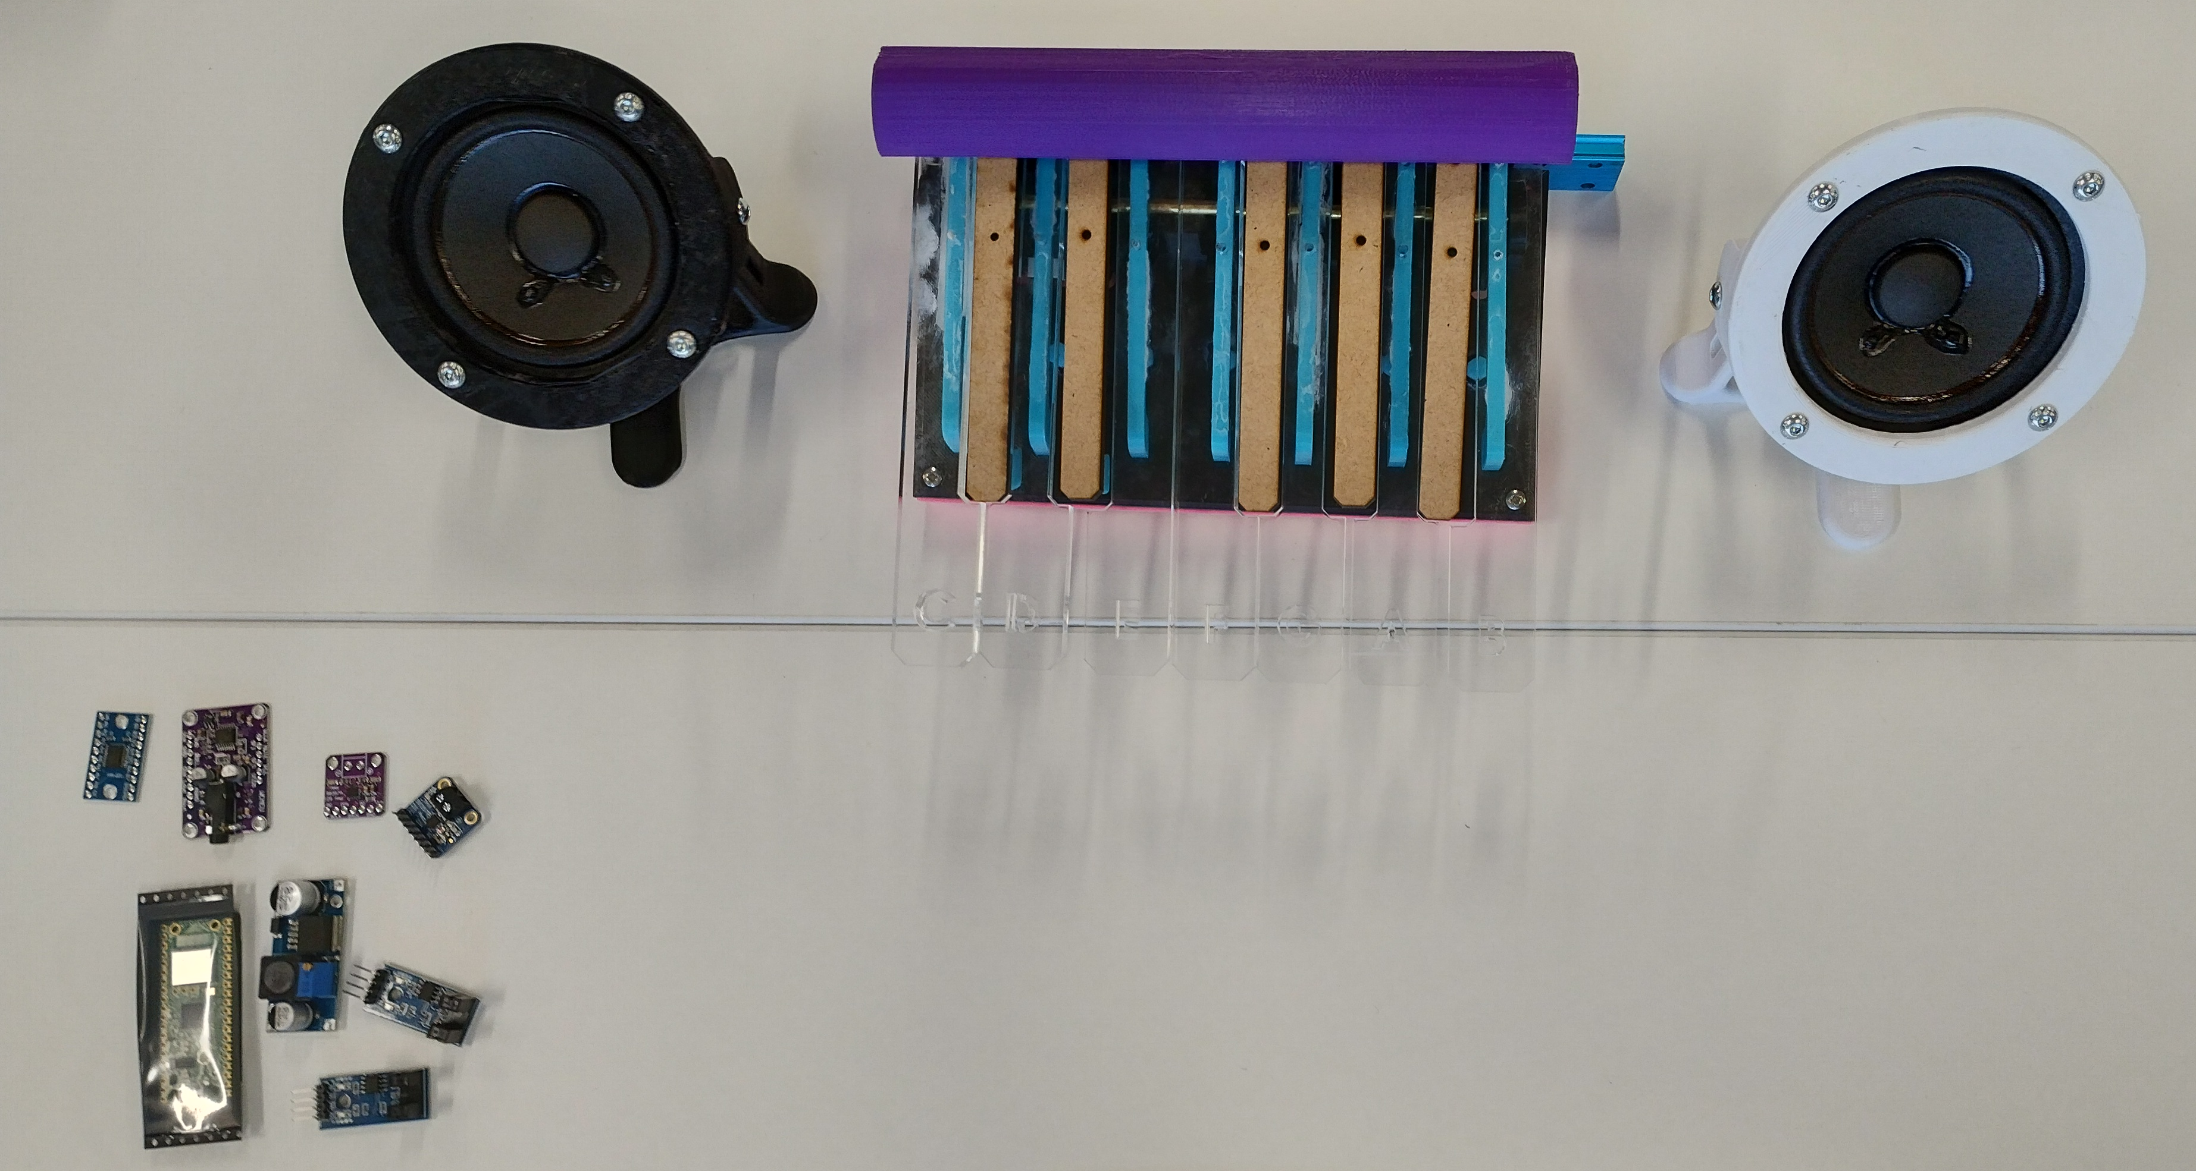
Other projects
A wide range of STEM related activities for engagement
Project 2: Collaborative crane
More challenging and include different platform communication
Project 3: Dynamic, auto-balancing beam
Physics based, with some control element
Project 4: Piano model
Give understanding how a digital piano model works and it’s fun

Slide 10
Feedback
Please let us know your thoughts during interaction and discussion
What’s your suggestions of STEM related activities that can be incorporated?
Any suggestions, please email Hin: hlim@waikato.ac.nz

