Slide 1
An online platform for enhancing teaching and learning experiences with web-based augmented reality and pictorial bar code.
Minh Nguyen
School of Engineering, Computer and Mathematical Sciences, AUT

Slide 2
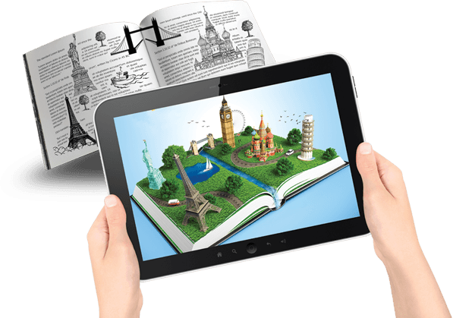
Motivation
My interests are in three major fields:
Virtual Reality (VR) and Augmented Reality (AR) innovation platform
Artificial Intelligence (AI)
Contemporary Educational Practice
I am passionate about developing new technology in education and always look for new ways to provide an effective and intuitive learning environment for ICT students.
I like to design learning tools and activities to embed computing technologies to make classroom education more interactive
For instance, using AR/VR to show demonstrations in 3D, bring drawing figures to life, and visually enhance students’ learning capability.

Slide 3
Lacking teaching materials is a common problem of many education systems
Lack of Resources in Classrooms
https://environmental-conscience.com/lack-of-education-causes-effects-solutions/

Slide 4
An online platform for enhancing teaching and learning experiences
We present an online study platform which is capable of running on an everyday handset without requiring any software installation.
It helps with the sustainable development goals of the UN:
Climate Action:
Less papers to be printed.
Fewer trees needed.
Affordable & Quality Education

Slide 5
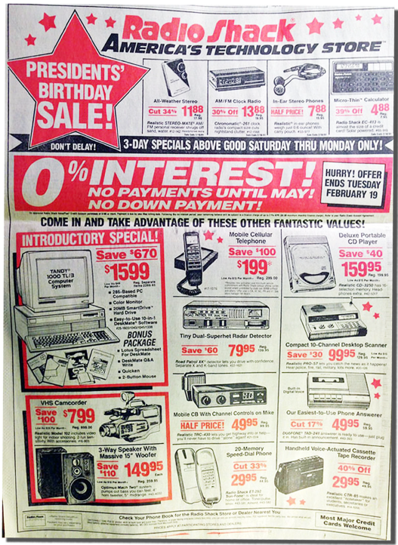
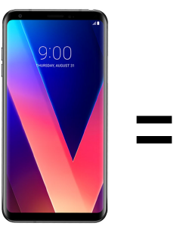
Digital technologies
Digital technologies are doing for human brainpower what the steam engine and related technologies did for human muscle power.
They're allowing us to overcome many limitations rapidly and to open up new frontiers with unprecedented speed.

Slide 6
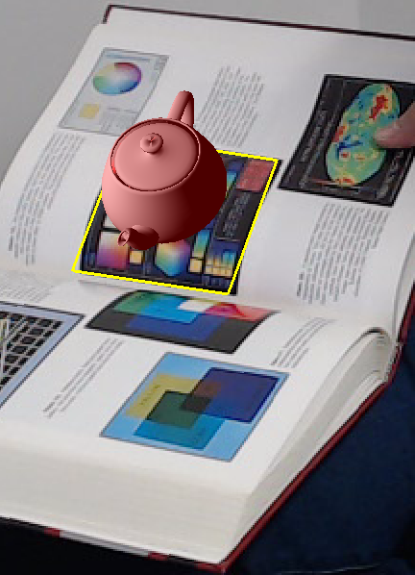
The proposed system
We design a transparent QR Code on colour images and Internet-downloadable 3D figures can be embedded for visualisation from a mobile web browser.
Instead of just black and white squares, our QR code is a colour picture; it is visible and detectable by available QR code scanners.
We allow a fascinating, interactive AR experience that can be achieved directly on a textbook’s page using a mobile browser.
This system enable a quick way to obtain and view many publicly available audio-enable books on the Internet using smart tablets.
The Internet transferring protocols are low cost and immediate.

Slide 7
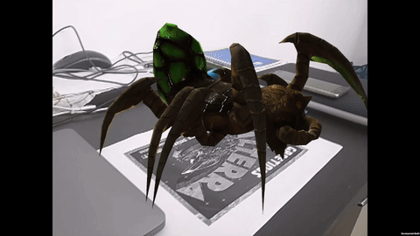
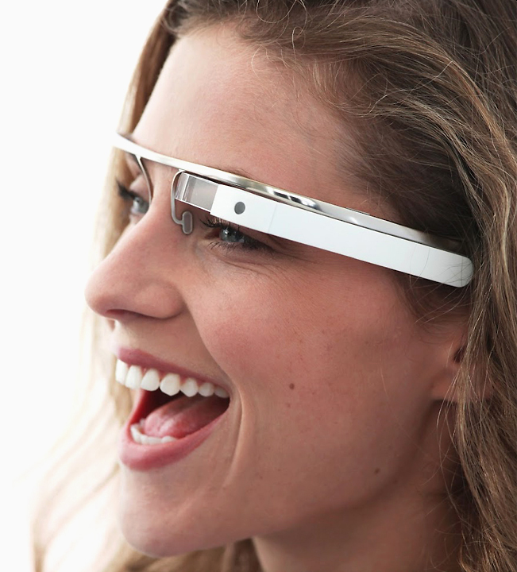
Background: current state of the art AR
Augmented reality is a subject of extensive research (50 years of age)
an active and exciting topic aiming to create intuitive computer interface by blending reality and virtual reality
virtual objects seamlessly superimpose upon a real environment in three dimensions and in real time
allowing users to interact with the digital contents easily.
significant increase thanks to recent advances in technologies; used in medical visualisation, manufacturing, maintenance and repair, path planning, entertainment, and military applications
AR applications for mobile devices have recently become the subject of special interest
Portable
Combines real and virtual
Is interactive in real time
Is registered in 3D

Slide 8
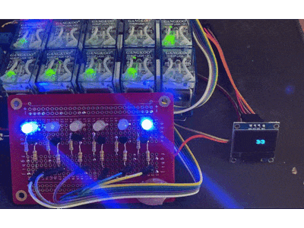
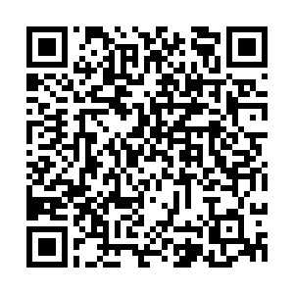
Computers & Binary Number System
Fundamentally, computer understand binary.
Human use base 10 / computer uses base 2
Communication between devices/CPUs:
Binary language: 0100001010100101…
But why Binary? Why can't computers just use base 10 instead of converting to and from binary?
Computers weren't initially designed to use binary... rather, binary was determined to be the best.
The basic component of a computer system is a transistor - a two state device which switches between logical “1” and “0”.
Bright & dark = 1 & 0
This is binary also

Slide 9
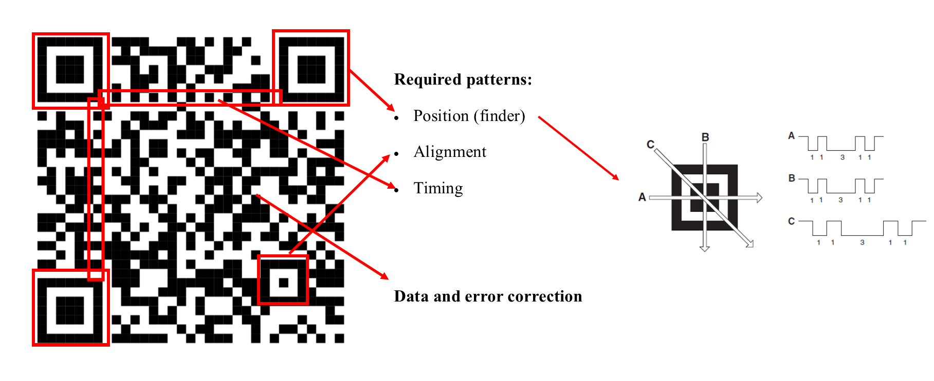
QR Code and avalable scanners
QR code structure overview:
The quick-response (QR) codes have become popular as one of the major tracking methods used in transport, manufacturing and many other different industries.
Nowadays, many mobile devices have been equipped with the QR code scan capability.
QR code has also been used as of the augmented reality (AR) marker due to its high storage capacity and speed of decoding.
QR code decoding algorithm
Today, the QR code is easily decoded with many built-in smartphone apps
The structure of the QR code usually includes three different regions. The message is encoded into the squared black and white boxes called as modules.
There are three regions:
Required patterns region
Data encoded region
Error correction region

Slide 10
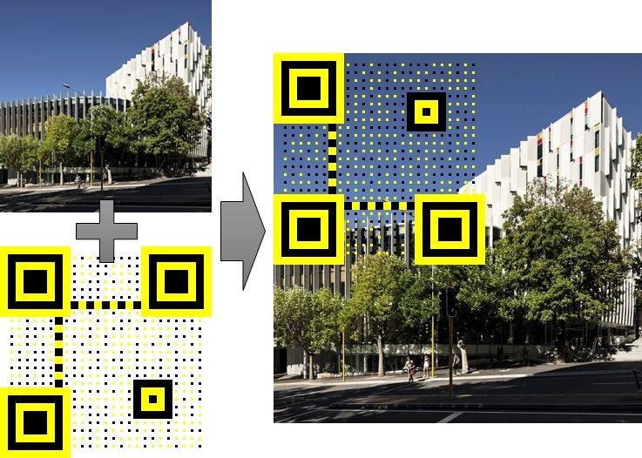
Transparent QR Code on Images
This transparent marker is designed to be printed directly on papers or printed on an adhesive transparent plastic using colour printer.
This transparent QR marker could be beneficial.
The transparent marker does not fully cover the texture content and the users are free to locate it at anywhere for the best readability.

Slide 11
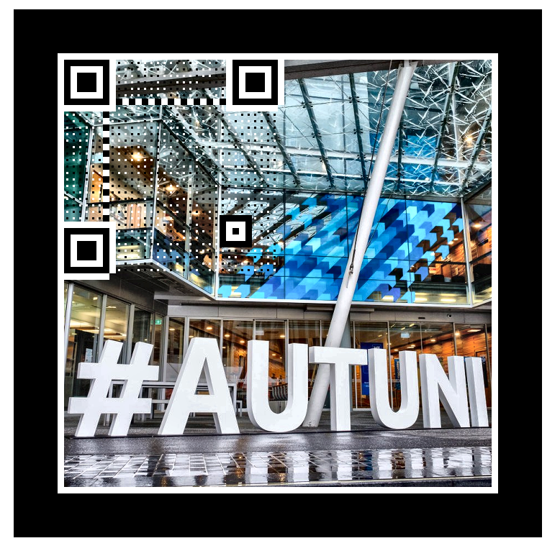
Creation of transparent QR on AR Tags
To make sure it is scan-able, the required patterns region must be kept, e.g. the four boxes.
Other black or white squares can be minimised to a single dot.
All the surroundings are made transparent.
Apply it on top of the image.
Wrap a black border around the image.

Slide 12
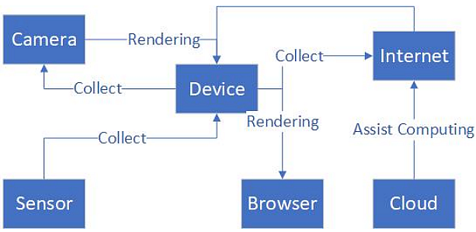
The Use of the Web technology
Web technology helps instantly achieving data, provides the freedom and flexibility to build expressive , it helps achieving 3 required required steps: recognising, tracking, rendering, displaying, etc.
Use sensors to provide more interactions, make the rendering more accurate, connect to the cloud through the network to accelerate calculations or exchange more data, etc.
This flow chart of our system has advantages in some aspects such as portability, rich sensors, and self-contained network.

Slide 13
Application 1: Pukapuka (book) portal
Our transparent QR Code is used to set up the core of the Pukapuka portal.
Several schools have the showcases: Devonport Primary School, Takapuna Grammar School, ACG International, …
It inter-connect 1126 book items on https://instructionalseries.tki.org.nz/
English medium literacy instructional series teaching and learning resources for years 1 to 8.
Just by one quick scan, the students/teachers can achieve instantly some of the following:

Slide 14
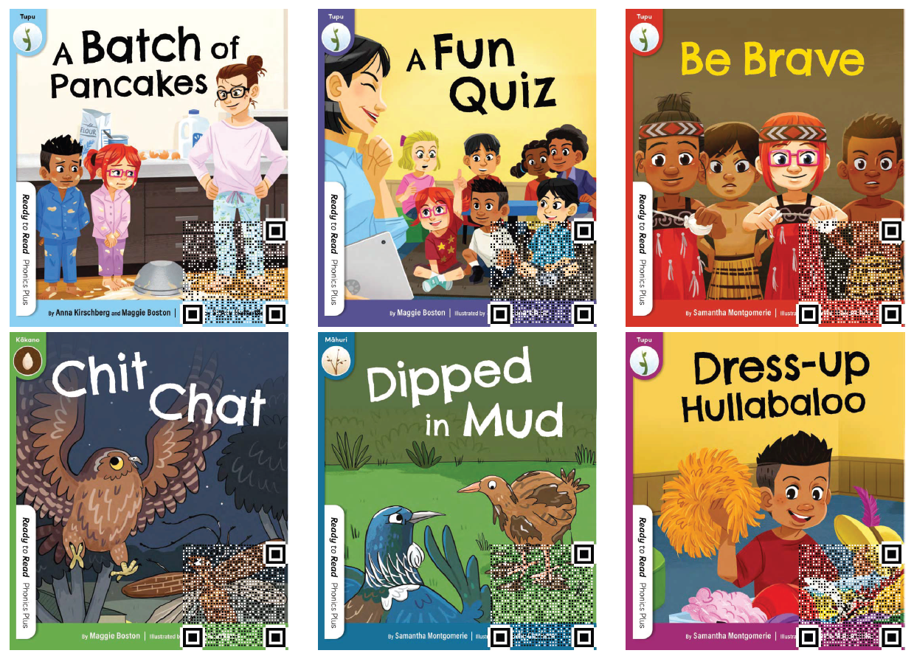

Slide 15
Application 2: A marker based Augmented Reality Platform
Predefined 3D is overlaid on top of a predefined marker
The prototype works on most iOS devices
The user scans the QR code to get to a website
Here, AR and its model are ready to display
Impressive 3D model render performance of approx. 60 fps.

Slide 16
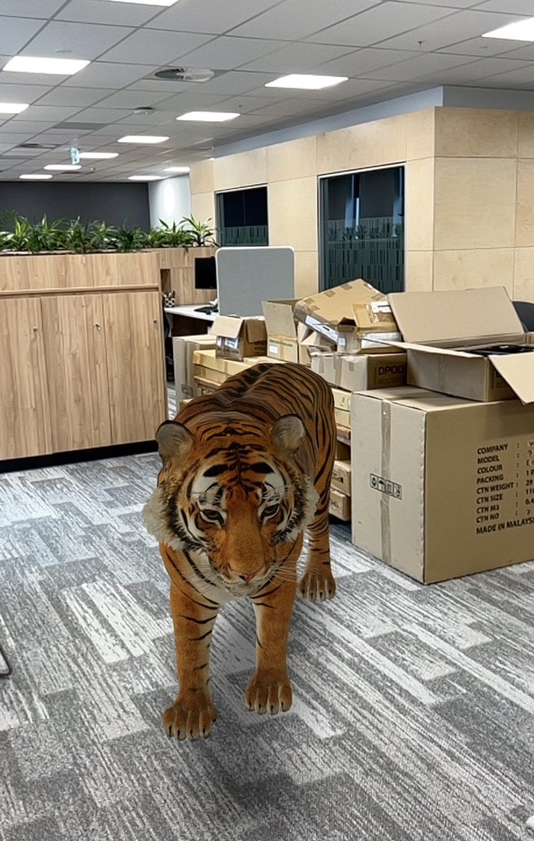
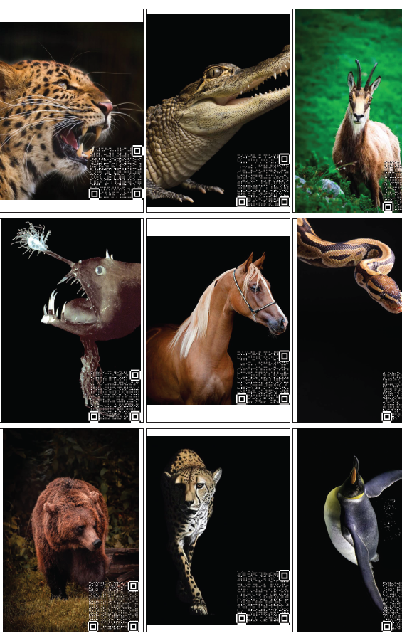
Application 3: A marker-less Augmented Reality Platform
Predefined 3D is overlaid on top of any surface
The prototype works on most iOS devices
The user scans the QR code to get to a website
Here, AR and its model are ready to display
Impressive 3D model render performance of approx. 60 fps.

Slide 17
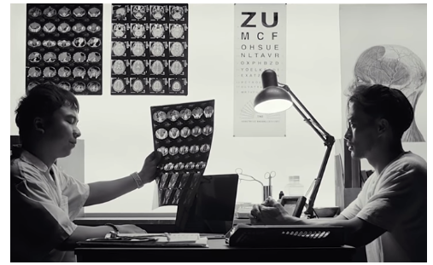
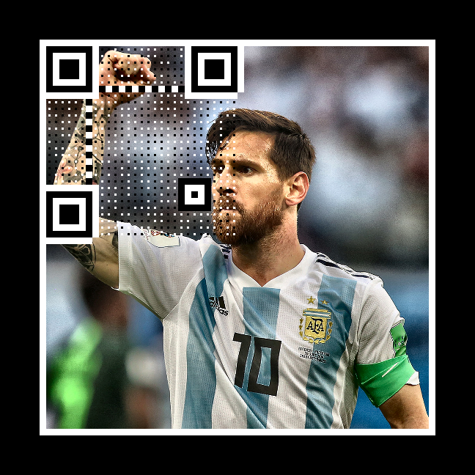
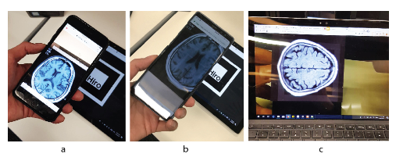
Application 4: instant View of 4D Medical Images
This tag is useful in many cases:
Replace ordinary QR code for extra information presentation
Quick display of all 3D models on Internet browsers
Applied in education, training, gaming, etc.
It could even help displaying instant View of 4D Medical Images
Computed Tomography (CT)
MRI (magnetic resonance imaging
https://cerv.aut.ac.nz/ar/mri/
Patient’s tag
Display of 200+ slides of scans interactively

Slide 18
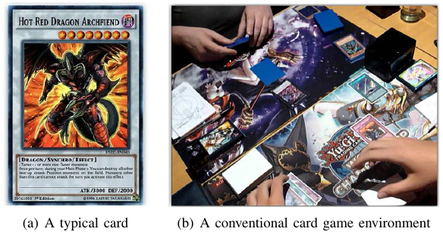
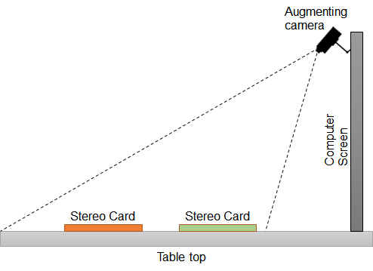
Many other Potential Applications
A trading card game (TCG) or frequently called collectible card game is a kind of card game that consists of a large variety of specially designed cards: Magic: “The Gathering”, “Yu-Gi-Oh”, etc.
incorporating Augmented Reality (AR) technologies into traditional TCGs.
Our QR Cards is suitable for table-top augmented reality game environment.
fit virtual characters and effects seamlessly superimposed upon the playing cards
replace the current cards in collectible card games.

Slide 19
Demonstrations and FAQs
We will try to create some examples of exercises that can be useful for high school teaching.
Download some demo codes:
https://cerv.aut.ac.nz/demo/demo.zip
Explore https://cvapp.aut.ac.nz/
Video Downloader: https://github.com/Alan528/COMP702-703Project-AUT-Video-download-GUI
Where to download 3D model?
https://sketchfab.com/
Can I create my own 3D model?
Yes

Slide 20
Conclusion
Our proposed transparent QR Code on colour images and how Internet-downloadable 3D figures can be embedded into textbooks’ figures for visualisation from a mobile phone web browser. Instead of just black and white squares, our QR code is a colour picture; it is visible and detectable by available QR code scanners.
This system described a quick way to obtain and view many publicly available stereo-viewable images on the Internet using VR headsets.
We presented a fascinating, interactive AR experience that can be achieved directly on a textbook’s page using a mobile browser.

Slide 21
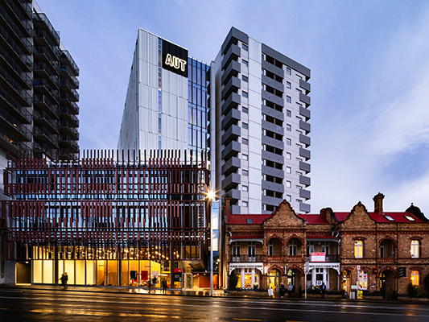
Q&A?
Thanks, please contact: minh.nguyen@aut.ac.nz

